Slide 1
Simple Harmonic Motion
Pendulums & Longitudinal Waves

Slide 2
Simple Harmonic Motion…
…is a form of periodic motion (repeated motion).
…is repeated motion over the same path.
…requires a restoring force that is constantly pushing the mass to equilibrium position.
…is demonstrated by pendulums and longitudinal waves.

Slide 3
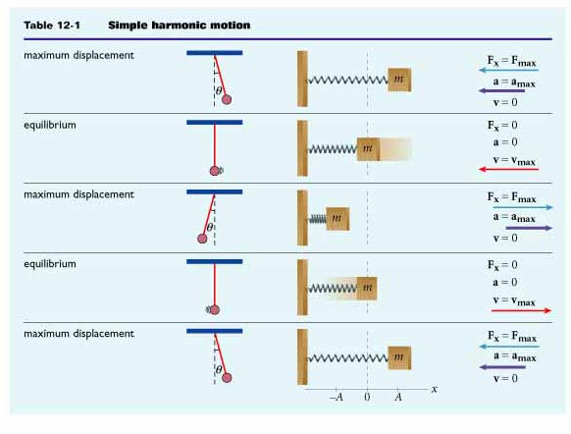
What does SHM look like?

Slide 4
Simple Definitions for SHM
Amplitude (A): Maximum displacement from equilibrium position; measured in meters (we’ll talk about this extensively in Unit 3)
Period (T): Time it takes for one complete cycle of the periodic motion; measured in seconds
Frequency (f): Number of cycles per unit of time; measured in Hertz (Hz) (1/s OR s⁻¹)
f = cycles/time
Relationship between Period and Frequency:
f=1/T
T=1/f
f = Frequency
T = Period

Slide 5
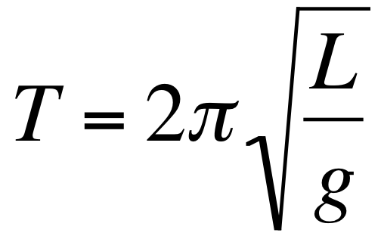
Pendulums
Restoring force is gravity.
Equation:
T = Period
L = Length of pendulum
g = acceleration due to gravity

Slide 6
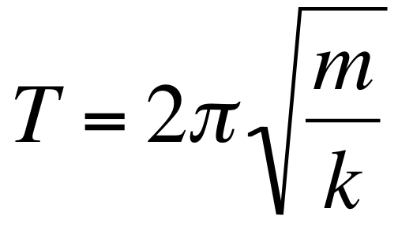
Longitudinal Waves
Restoring forces are the spring and gravity.
Remember Hooke’s law: F = kΔx
Equation:
T = Period
m = mass
k = spring constant

Slide 7
A pendulum is observed to complete 23 full cycles in 58 seconds. Determine the period and the frequency of the pendulum.
Cycles = 23
t = 58 s
f = ?
T = ?
f = cycles/t
T = 1/f
f = 23/58s
T = 1/.397
f = .397 Hz
T = 2.52 s

Slide 8
On top of a mountain a pendulum 1.55 m long has a period of 2.51 s. What is the acceleration due to gravity at this location?
L = 1.55 m
T = 2.51 s
g = ?
T = 2π√L/g
2.51 = 2π√1.55/g
2.51/2π = √1.55/g
.399 = √1.55/g
(.399)² = [√1.55/g]²
.1596 = 1.55/g
.1596 g = 1.55
g = 1.55/.1596
g = 9.71 m/s²

Slide 9
What is the length of a simple pendulum whose period is 1.00 s?
L = ?
T = 1.00 s
g = 9.8 m/s²
T = 2π√L/g
1.00 = 2π√L/9.8
1.00/2π = √L/9.8
.159 = √ L/9.8
(.159)² = [√ L/9.8]²
.0253 = L/9.8
.0253*9.8 = L
.248 m = L

