Slide 1
Projectile Motion

Slide 2
What is a projectile?
A projectile is an object moving in two dimensions under the influence of Earth's gravity; its path is a parabola.
Notes:
Figure 3-19. Caption: This strobe photograph of a ball making a series of bounces shows the characteristic “parabolic” path of projectile motion.

Slide 3
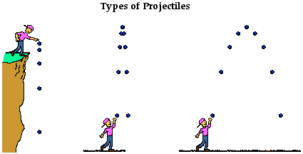
What is a projectile?
A projectile is an object upon which the only force acting is gravity. A projectile is any object which once projected or dropped continues in motion by its own inertia and is influenced only by the downward force of gravity.

Slide 4
3-7 Projectile Motion
The speed in the x-direction is constant; in the y-direction the object moves with constant acceleration g.
This photograph shows two balls that start to fall at the same time. The one on the right has an initial speed in the x-direction. It can be seen that vertical positions of the two balls are identical at identical times, while the horizontal position of the yellow ball increases linearly.
Notes:
Figure 3-21. Caption: Multiple-exposure photograph showing positions of two balls at equal time intervals. One ball was dropped from rest at the same time the other was projected horizontally outward. The vertical position of each ball is seen to be the same at each instant.

Slide 5
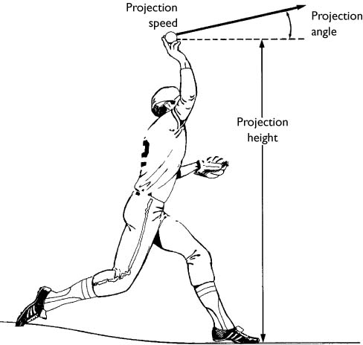
Factors Influencing
Projectile Trajectory
Trajectory: the flight path of a projectile
Angle of projection
Projection speed
Relative height of projection
Notes:
Trajectory: the flight path of a projectile
Three factors influence the trajectory of a projectile: the angle of projection, the projection speed, and the relative height of projection.
Understand how these factors interact is useful within the context of a sport both for determining how to best project balls and other implements and for predicting how to best catch or strike projected balls.

Slide 6
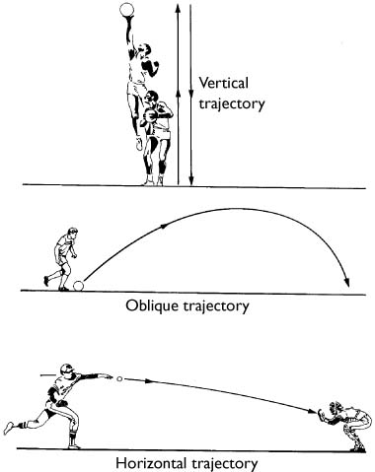
Factors Influencing
Projectile Trajectory
Angle of Projection
General shapes
  Perfectly vertical
  Parabolic
  Perfectly horizontal
Implications in sports
Air resistance may cause irregularities
Notes:
The angle of projection and the effects of air resistance govern the shape of a projectile’s trajectory.
Angle of Projection: the direction at which a body is projected with respect to the horizontal
In the absence of air resistance, the trajectory of a projectile assumes one of three general shapes, depending on the angle of projection.
General shapes
Perfectly vertical – projectile follows same path straight up and then straight down again
Parabolic – an oblique projection angle (0⁰-90⁰), the trajectory is parabolic
Shaped like a parabola
Symmetrical, right & left halves are mirror images
Perfectly horizontal – at an angle of 0⁰, the trajectory resembles one half of a parabola.
Projection angle has direct implications for success in the sport of basketball, since a steep angle of entry into the basket allows a some-what larger margin of error than a shallow angle of entry.
In projection situations on a field, air resistance may, in reality, create irregularities in the shape of projectiles, trajectory.

Slide 7
Projectile Motion
It can be understood by analyzing the horizontal and vertical motions separately.
Notes:
Figure 3-20. Caption: Projectile motion of a small ball projected horizontally. The dashed black line represents the path of the object. The velocity vector at each point is in the direction of motion and thus is tangent to the path. The velocity vectors are green arrows, and velocity components are dashed. (A vertically falling object starting at the same point is shown at the left for comparison; v_{y} is the same for the falling object and the projectile.)

Slide 8
Solving Problems Involving Projectile Motion
Read the problem carefully.
Draw a diagram.
List what you know from the problem and what you need to solve for.
Determine which equations for vertical motion or horizontal motion will help you solve the problem. You may need more than one equation.
Examine the x and y motions separately.
Solve the problem and check your work.

Slide 9
Equations for Projectile Motion
Horizontal distance: ∆X_{x}= v_{x}t
Vertical velocity: v_{y}=at (a=g=9.8m/s²)
Vertical distance: ∆x_{y}= 1/2at² (a=g=9.8 m/s²)
Notes:
When a body is moving with a constant acceleration (positive, negative, or equal to 0), certain interrelationships are present among the kinematic quantities associated with the motion of the body.

Slide 10
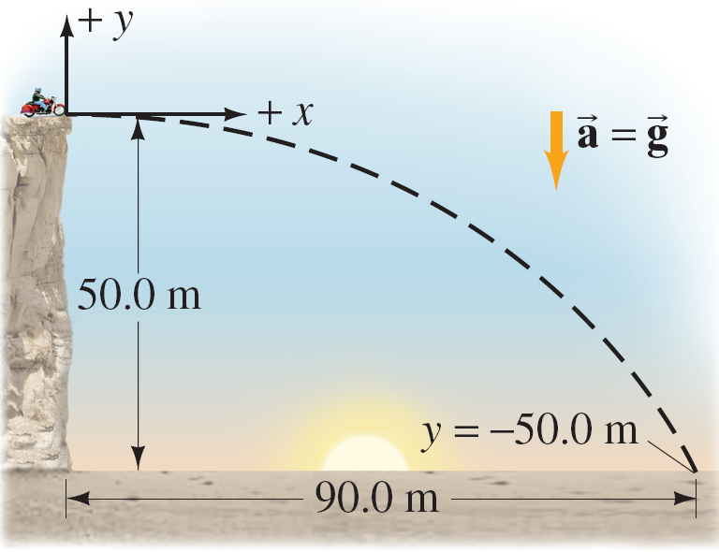
A movie stunt driver on a motorcycle speeds horizontally off a 50.0-m-high cliff. How fast must the motorcycle leave the cliff top to land on level ground below, 90.0 m from the base of the cliff where the cameras are? Ignore air resistance.
∆X_{x}= v_{x}t
∆X_{x}/t = v_{x}
v_{x} = ?
∆x_{y} = 50m
t = ?
∆x_{x} = 90m
a = g = 9.8m/s²
= 28.21
v_{x} = ∆X_{x}/t
v_{x} = 90/3.19
∆x_{y}= 1/2at²
= 3.19
v_{x} = 28.21
√∆x_{y}/(1/2a) = t
t = √∆x_{y}/(1/2a)
t = √50/(1/2(9.8))
t = √50/(4.9)
t = 3.19
Notes:
Figure 3-23.
Answer: The x velocity is constant; the y acceleration is constant. We know x₀, y₀, x, y, a, and v_{y0}, but not v_{x0} or t. The problem asks for v_{x0}, which is 28.2 m/s.

Slide 11

A boy runs at a speed of 3.3 m/s straight off the end of a diving board that is 3 m above the water. How long is he airborne before he hits the water? What is the horizontal distance he travels while in the air?
y
∆x_{y}= 1/2at²
∆X_{x}= v_{x}t
√∆x_{y}/(1/2a) = t
∆X_{x}= 3.3x.78
t = √∆x_{y}/(1/2a)
∆X_{x}= 2.574
v_{x} = 3.3m/s
∆x_{y} = 3m
t = ?
∆x_{x} = ?
a = g = 9.8m/s²
t = √3/(1/2(9.8))
= .78s
t = √3/(4.9)
= 2.574m
t = .78
x

Slide 12
Summary
A projectile is a body in free fall that is affect only by gravity and air resistance (which we are ignoring).
Projectile motion is analyzed in terms of its horizontal and vertical components.
  Vertical is affected by gravity
Factors that determine the height & distance of a projectile are; projection angle, projection speed, and relative projection height

