Slide 1
Free Fall

Slide 2
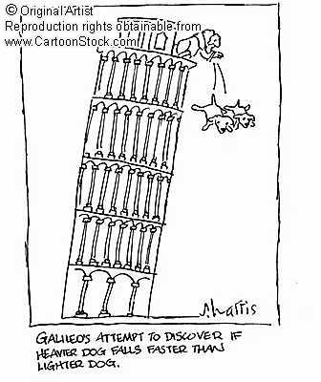
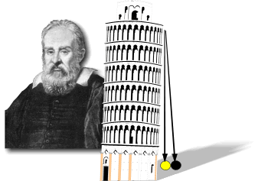

Slide 3
Free Fall
Objects whose only acceleration is due to gravity are in free fall.
Theoretically, objects in free fall continue to accelerate as long as they are falling.
All free falling objects accelerate at the same rate regardless of their mass. (9.8 m/s²)

Slide 4
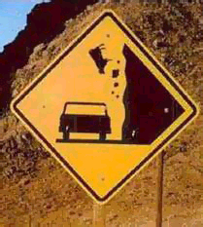
Free fall
The constant acceleration of an object moving only under the force of gravity is "g".
If there was no air, all objects would fall at the same speed
Doesn’t depend on mass

Slide 5
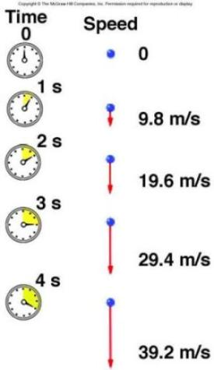
Free Fall
The rate of falling increases by 9.8 m/s every second (m/s²).
Time (s) Velocity (m/s)
0 0
1 - 9.8
2 - 19.6
3 - 29.4
4 - 39.2
5 - 49.0

Slide 6
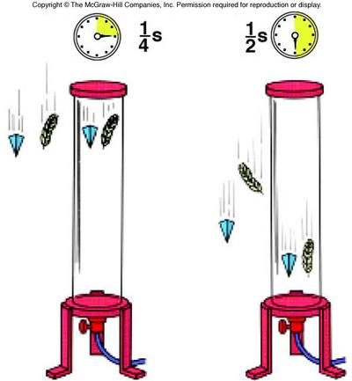
Air Resistance
In air…
A stone falls faster than a feather
Air resistance affects stone less
In a vacuum
A stone and a feather will fall at the same speed.

