Slide 1
Energy
Part 3 – Hooke’s Law

Slide 2
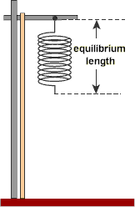
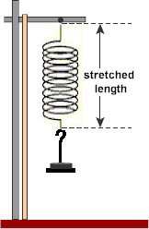
Hooke’s Law
Hooke's Law gives the relationship between the force applied to an unstretched spring and the amount the spring is stretched.
F = -kΔx

Slide 3
Hooke’s Law
Hooke's Law is about stretching springs (and other elastic objects).
Hooke's Law states that the stretch of the spring (Δx) is proportional to the force (F).
the spring will go back to its original length when the force is removed.

Slide 4
How does a spring behave? Spring Lab Recap
We conducted an experiment to determine how the stretch of a spring varies with the force (F_{A}).
A spring was hung vertically from a fixed point and force was applied in stages by hanging weights from the spring.

Slide 5
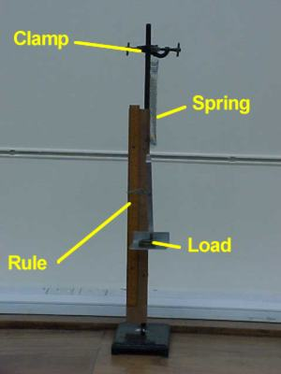
Stretch (Δx) = final length – initial length
The apparatus was set up similar to the diagram shown. For the purposes of the experiment we increased the mass, and the extension of the spring was measured in meters.

Slide 6
Graph: Plot a graph of force against stretch of spring.
“Rigid” Spring
“Loose” Spring
F = Force (N)
Δx = Stretch of Spring (m)

Slide 7
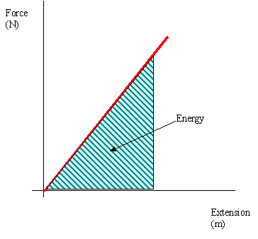
What does the area under a graph represent?
ENERGY!!!

