Slide 1
Dimensional Analysis

Slide 2
Dimensional Analysis
What happens when you divide a number by itself?
What happens when you divide a unit by itself?
In both cases, you get the number 1.
Dimensional analysis involves multiplication and division.
Focus on cancelation of UNITS
Just another method of unit conversion

Slide 3
Conversion factors
To convert between units:
Figure out what CONVERSION FACTOR you need to perform your calculation
Conversion factors – take a definition and turn it into a fraction equal to one – for example:
There are 12 inches in 1 foot
12 inches or 1 foot
1 foot 12 inches

Slide 4
Example of dimensional analysis
Convert 2.6 km to mm
First- what is the desired unit?
Answer- mm
Second- how do we get from km to mm?
We know that 1 km = 1000 m
We know that 1 m = 1000 mm
2.6 km
1000 m
1000 mm
=
2,600,000 mm
1 km
1 m

Slide 5
Examples
mega- | M | million | 1,000,000 | 10⁶
kilo- | k | thousand | 1,000 | 10³ | kilograms
deci- | d | tenth | 1/10 = 0.1 | 10⁻¹ | dm³=liter
centi- | c | hundredth | 1/100 = 0.01 | 10⁻² | cm=centimeter cc=cubic cm
milli- | m | thousandth | 1/1000 = 0.001 | 10⁻³ | mg=milligram mL=milliliter
micro- | µ | millionth | 1/1,000,000 = 0.000001 | 10⁻⁶ | µg=microgram
nano- | n | billionth | 1/1,000,000,000 = 0.000000001 | 10⁻⁹ | nm=nanometers
Metric facts: 1 cubic centimeter = 1 milliliter (1 cc=1mL) Liter = 1 cubic decimeter = 1,000 cubic centimeters = 1,000 milliliters Lower case “m” stands for meter or “milli”. Capital “L” for liter.

Slide 6
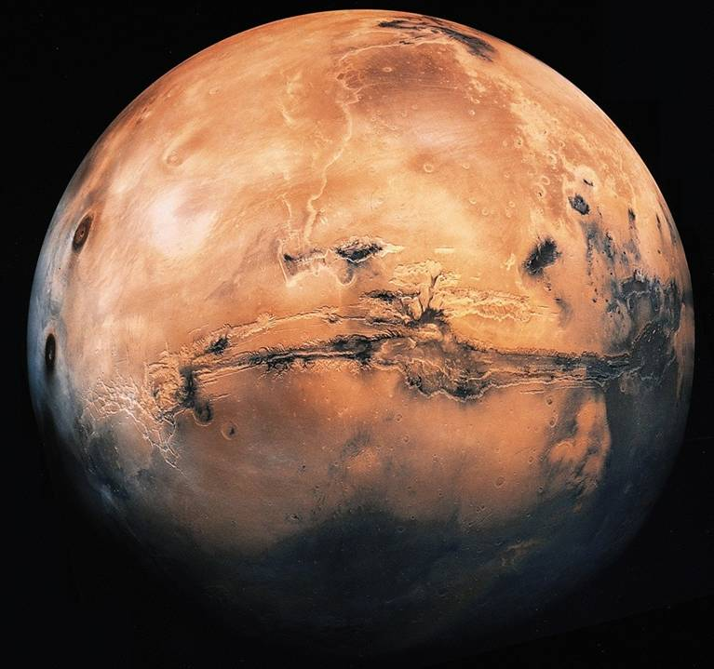
The loss of the Mars Climate Orbiter on September 23, 1999, was a most unfortunate and highly avoidable event.
The cause of the mishap has been traced to a mix-up over units. Preliminary findings indicated that one team used English units (e.g., inches, feet and pounds) while the other used metric units for maneuvers required to place the spacecraft in the proper Mars orbit.
The 'root cause' of the loss of the spacecraft was the failed translation of English units into metric units.
For nearly three centuries, engineers and scientists have been struggling with English units.

